Slide 1
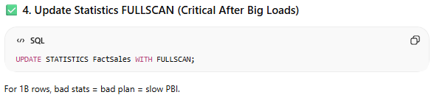
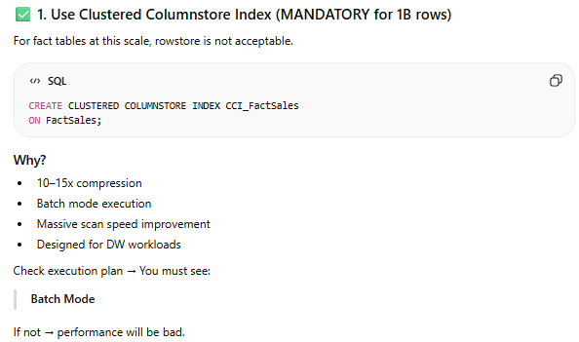
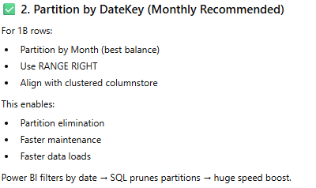
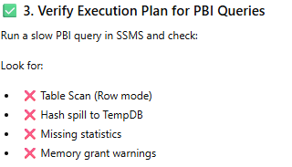
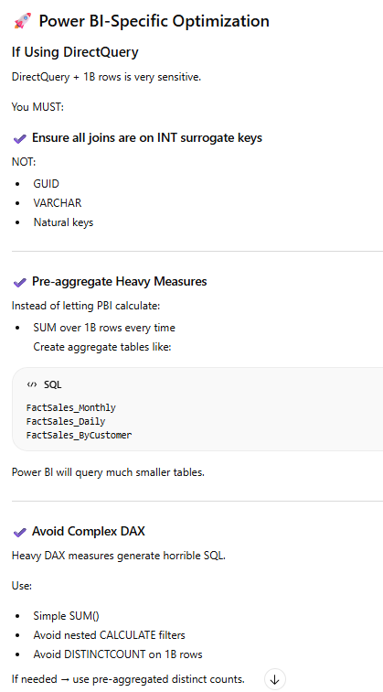
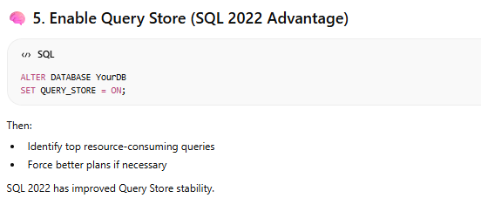
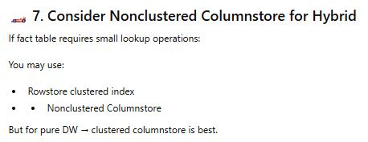
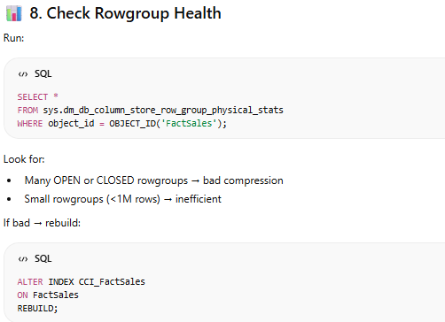
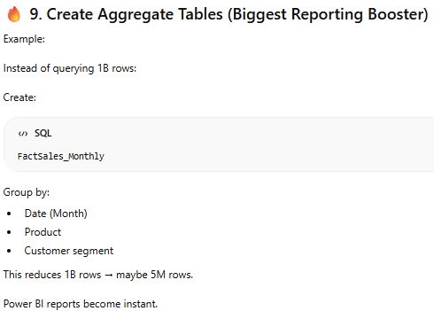
Performence tunning

Slide 2
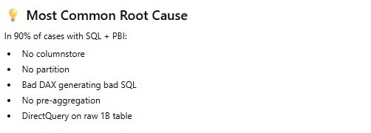
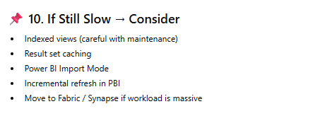
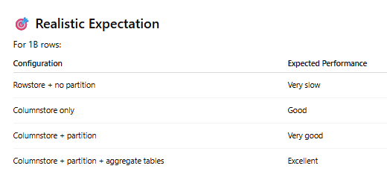
Performence tunning

Slide 3
PBI Problems solving
Topic 1 :
Goal : reduce report (fact table of 1 billion rows ) load time from several minute to less than 1 min
Problem
Fact table in sql server 2022 (1 billion rows) – Repofrt load time 6 to 10 min – Visuals timing out -- Power Bi Sevice refresh failure –
Root cause :
No partitionfor the big fact table – No index strategy – Complex Dax queries with nested Filers – Import mode with full refrsh – No Incremental load set up –Data model not properly created
Soluition
Database : Implement table partition (by year/Month) –Add column store index – Update the fact tables statistics , create some views instead of using the tabls it self.
Data model : Create a proper star / Snauflake model , remove bi-directionel relationships , reduce cardinality when there were to mush , Replace calculated column by using measure or calculate some kpi on view lavel , implement a proper incremental load and refresh
Capacity optimisation : Schedul teh refresh during the low-usage period , Monitor the performence using Performence Analyzer and Dax studion
Result
Load time reduce from 6 min to 30 sec
Data size reduced by 60% using index
Refrech time reduce
User confidence in the reporting increase
TopIC 2 :
Goal : Compare revunue numbers in power and a ERP application
Problem
The revunue values in the financial application did not match the value in power bi
Root cause :
Duplicate rows – Different revenue calculation logic – some currency conversion not doen correctly using DAX
Soluition
Data validation : Create a reconsiliation table (ERP and Power BI ) , check delta on daily basis
Data model fix : Replace the many to many relatuonship by implementing bridges tables – Standardize the KPI calcutions (agrement with the business) – create a proper currency fact table instesd of using DAX
Data gouvernance: Documentation of all KPI’s – Implementation of Sementic layer standadisation – Create a Data quality dashboad using teh consiliation table , delta..
Result
100% kpi missmatch eliminated
The trust on reporting increased

Slide 4
PBI Problems solving
Topic 3 :
Problem
How to increase the reporting performance , when total rows is more than 1 billions ,
Performence investigation tools
Performense analyzer – DAX studio –Vertipaq analyzer – usage metrics report (Fabric Capicity Metric app) – SQL exceution plan check
Perfomence analysis
Check : storage mode import/DQ/dual – Star /Snowflake in the model – Colum cardinaties – bidirectional relationships—Many to many relationships –Incremental refresh configured – Fact Table partition implamented – columnstore index on fact table – Use of aggregated tables -- ?
Probable solution :
Data model : Design a proper sementic data model with a STAR structure including bridgs tables instead of using many to many realtionships and removing snoflake configuration by doing great denormalizing in the model
Performence issue fixes : Replace calculated column by measuers , reduce caridinalties , remove unsued columns, Optimize DAX , using variables , use less Filters() function , implemente aggregated tables (1B row is only used for drillthrough and aggregated tables 5 to 6 m rows for most visuals) , Enable Incremental refresh
Database : for big fact table use Clusted Column Index (CCI) ,Remove or modify unnecessary Nvarchar data type , partitionning of the table , Pre-aggregate heavy logic (by doing complex caculation and large volume computation on the source not on Power BI) , Validate excecution plan
Data validation : Reconsiliation tables (between 2 app to track data discrepencies) , implement data quality dashboard
Capcity and scaling Strategy : Identify memory spikes , reduce parallel refresh , Stagger data refresh , Evalute Hybrid tables , Propose scale-up or optimize before scalling

Slide 5
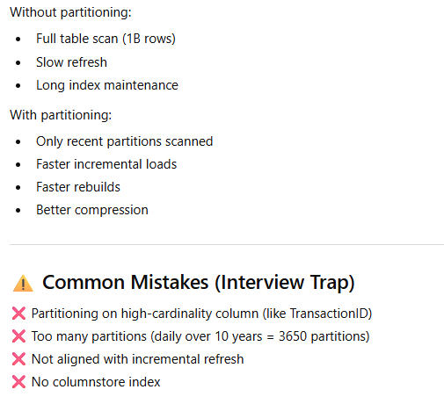
Partition big table (fact)
Create partition on fact tables
Step1 : Create partition function
Create Parition Function pf_FactEnergy_ByYear (date) as range right for values (‘2022-01-01’,’2023-01-01’,’2024-01-01’)
Stpe2 : create partition Sheme
CREATE PARTITION SCHEME ps_FactEnergy_ByYear AS PARTITION pf_FactEnergy_ByYear ALL TO ([PRIMARY]);
Step3: Create partitioned fact table
CREATE TABLE dbo.FactEnergyProduction ( ProductionID BIGINT IDENTITY(1,1), PlantID INT NOT NULL, EnergyProduced DECIMAL(18,2), CostAmount DECIMAL(18,2) ) ON ps_FactEnergy_ByYear (ProductionDate);
Step3 : Add Clusterd columnstrore index
CREATE CLUSTERED COLUMNSTORE INDEX CCI_FactEnergy ON dbo.FactEnergyProduction;
Step4 : add new partition
ALTER PARTITION FUNCTION pf_FactEnergy_ByYear() SPLIT RANGE ('2027-01-01’);
Step5 : Archive oldest partitions
ALTER TABLE dbo.FactEnergyProduction SWITCH PARTITION 1 TO dbo.FactEnergyProduction_Archive;
Performance impact

Slide 6
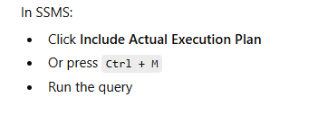
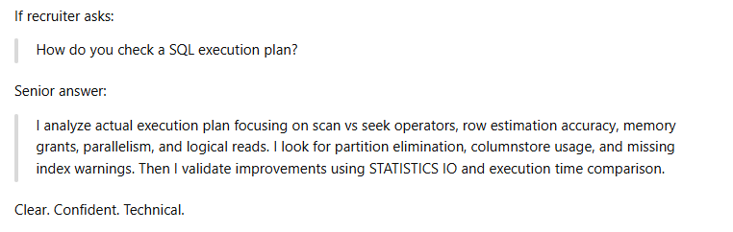
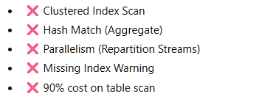
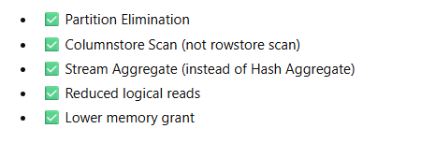
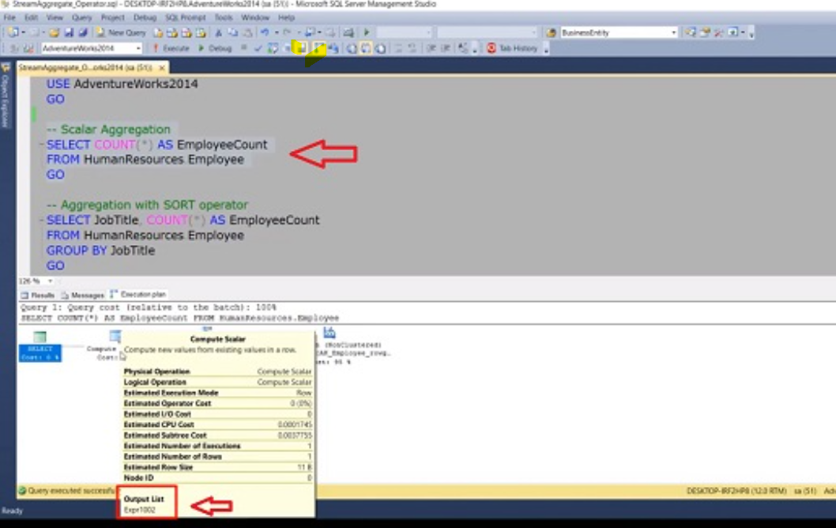
SQL execution plan analysis and statistics
Analysis
Power bi sends the following query to the sql engine
SELECT PlantID, SUM(EnergyProduced) AS TotalEnergy FROM dbo.FactEnergyProduction WHERE ProductionDate >= '2024-01-01' GROUP BY PlantID;
To ccheck the exacution plan do the followings:
Some typical bad and goodoutput
Some interpratation and fix
When reviewing a ex plan check
Estimated vs Actual
If Estimate = 1k rows and actual = 50 M row → Statistics are outdated
Update the statistics → Update STATISTICS dbo.facttable
Check logical reads
Run this query → SET STATISTICS IO ON
If Logical reads = millions then it a Problom
Typical question and answers

